Slide 1
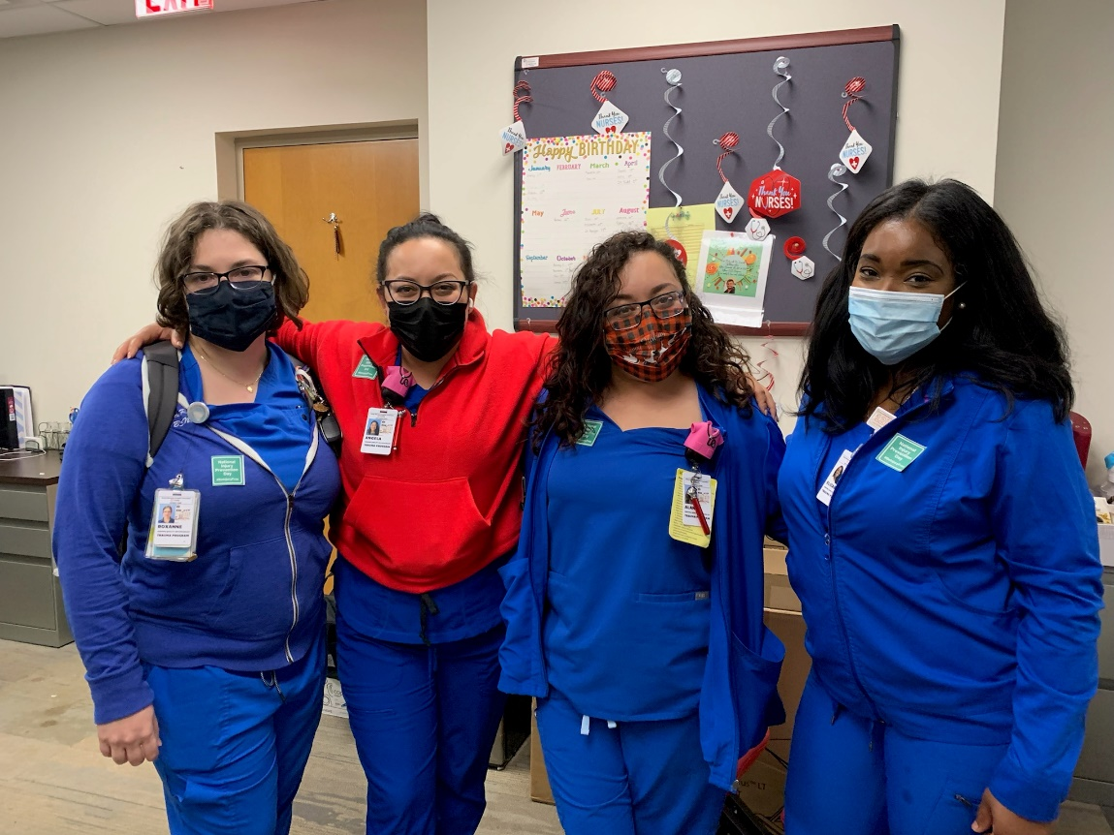
Announcements & safety giveaways at morning report, MTC staff meeting (11/18 AM), and MTC PM huddle
Stickers & flyers
Social media posts
Twitter chat
Email signature message
Inside Grady Weekly

Slide 2
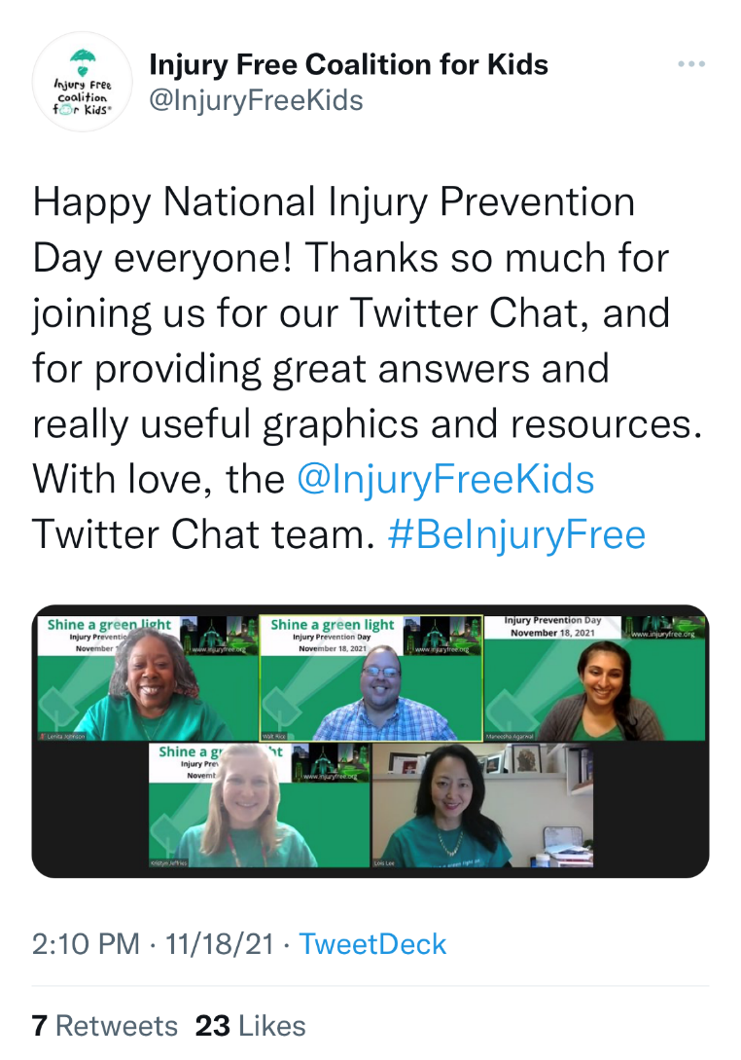
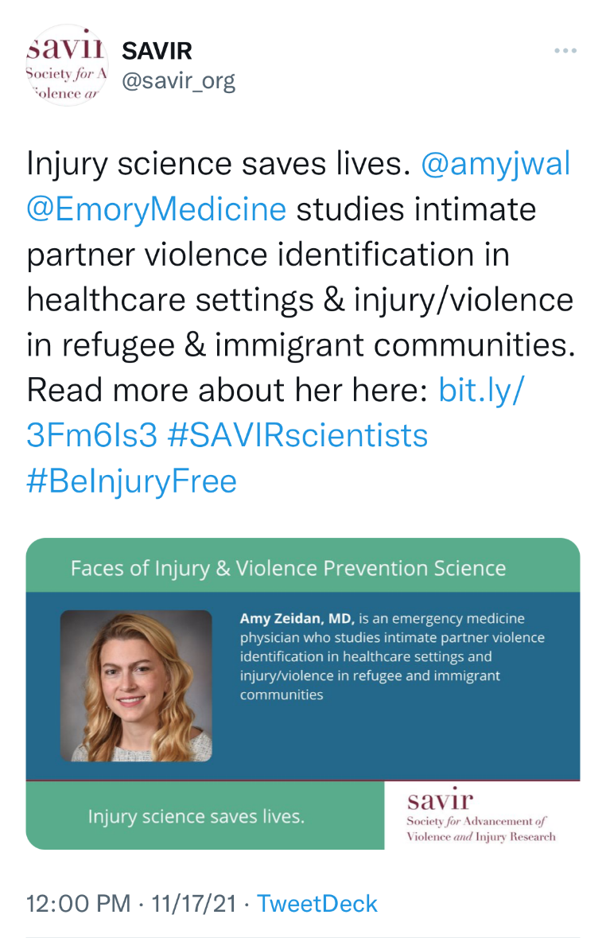

Slide 3
Method | # Reached
Morning report, MTC AM staff meeting, MTC PM huddle | 55
Inside Grady Weekly | 8,000
Social media posts | 45
Twitter chat | 150
Stickers | 50

Slide 4
